Slide 1
BeHive Academy
Start Your Career In China
Notes:
Soft skills are a combination of: people skills,
social skills,
communication skills,
character traits,
attitudes,
career attributes,
social intelligence and emotional intelligence quotients, etc.
why important: enable people to navigate their environment, work well with others, perform well, and achieve their goals with complementing hard skills.

Slide 2
Contents
Problem opportunity
Our Experience
Our Solution
Underlying Magic (angel)
Business Model (harris)
Go-to-Market plan (laura)
Competitive Analysis
Management Team
Financials (harris)
Future plans (mentorship, recruitment)
Notes:
Fix

Slide 3
Notes:
time, money lost on recruitment, training, compensation, etc.
long lasting negative effects on a team or company’s culture - reduced productivity or morale.
Kai Fu Lee said that he believes 40% of the world’s jobs will be replaced by robots capable of automating tasks
Only about a third of U.S. companies report that they monitor whether their hiring practices lead to good employees Harvard Business Review- https://elb.hbr.org/2019/05/recruiting#your-approach-to-hiring-is-all-wrong
The time companies spend on job interviews and hiring processes has grown in recent years, internationally. – Glassdoor (2015)
TRAINING:
Specialized soft skills training is expensive and not easily accessible to students.
Skills training is not tailored for students who want to work/study abroad.
HIRING:
Traditional hiring methods are costly, time-consuming, and sometimes fail at selecting the best talent.
Bad employee hires can bring short- & long-term negative effects to companies.

Slide 4
Problem
Foreigners in China have a hard time landing a job.
They have no local network or connections.
It’s challenging to get the information they
need to make informed career decisions.
Notes:
time, money lost on recruitment, training, compensation, etc.
long lasting negative effects on a team or company’s culture - reduced productivity or morale.
Kai Fu Lee said that he believes 40% of the world’s jobs will be replaced by robots capable of automating tasks
Only about a third of U.S. companies report that they monitor whether their hiring practices lead to good employees Harvard Business Review- https://elb.hbr.org/2019/05/recruiting#your-approach-to-hiring-is-all-wrong
The time companies spend on job interviews and hiring processes has grown in recent years, internationally. – Glassdoor (2015)
TRAINING:
Specialized soft skills training is expensive and not easily accessible to students.
Skills training is not tailored for students who want to work/study abroad.
HIRING:
Traditional hiring methods are costly, time-consuming, and sometimes fail at selecting the best talent.
Bad employee hires can bring short- & long-term negative effects to companies.

Slide 5
Our Past Experience
80+
9000+
50+
career &
networking events
online followers
Trainers & speakers
$15,000+
8000+
65+
Corporate clients &
sales revenue
participants
Companies &
organizations
28
Notes:
Need to add feedback and surveys
+ number of trainers number of topics
Sponsorship – 26 + 2

Slide 6
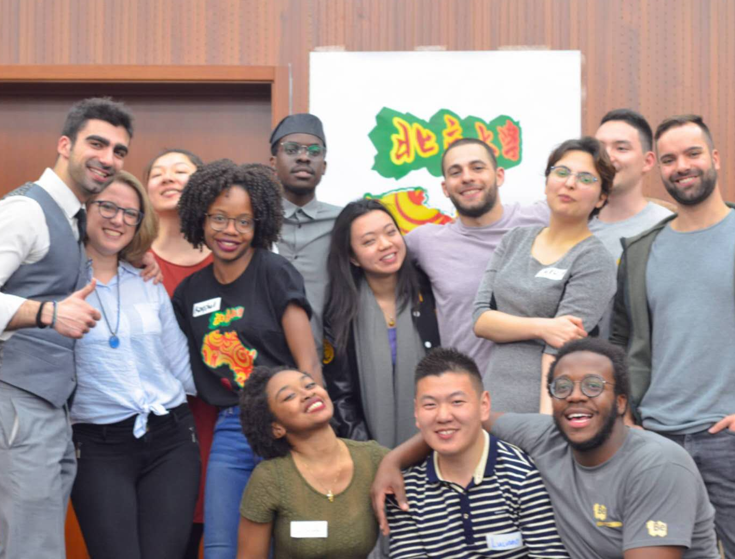
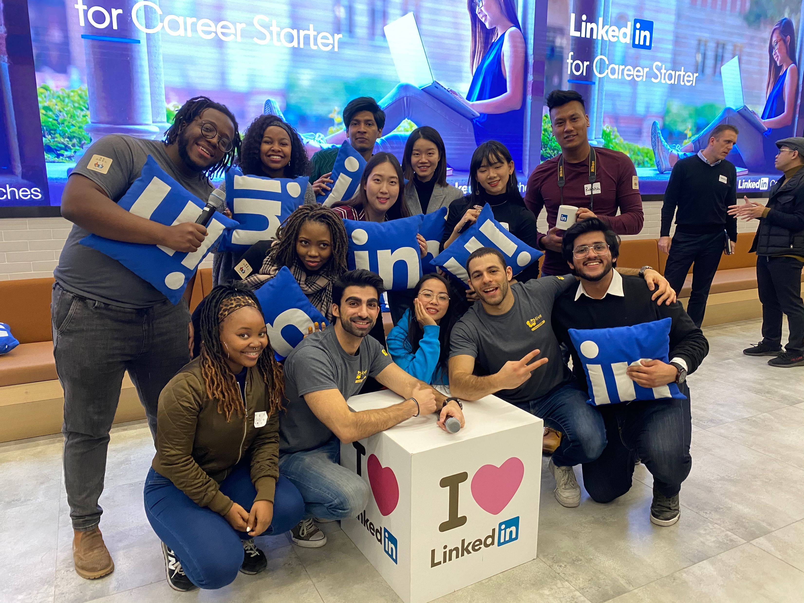
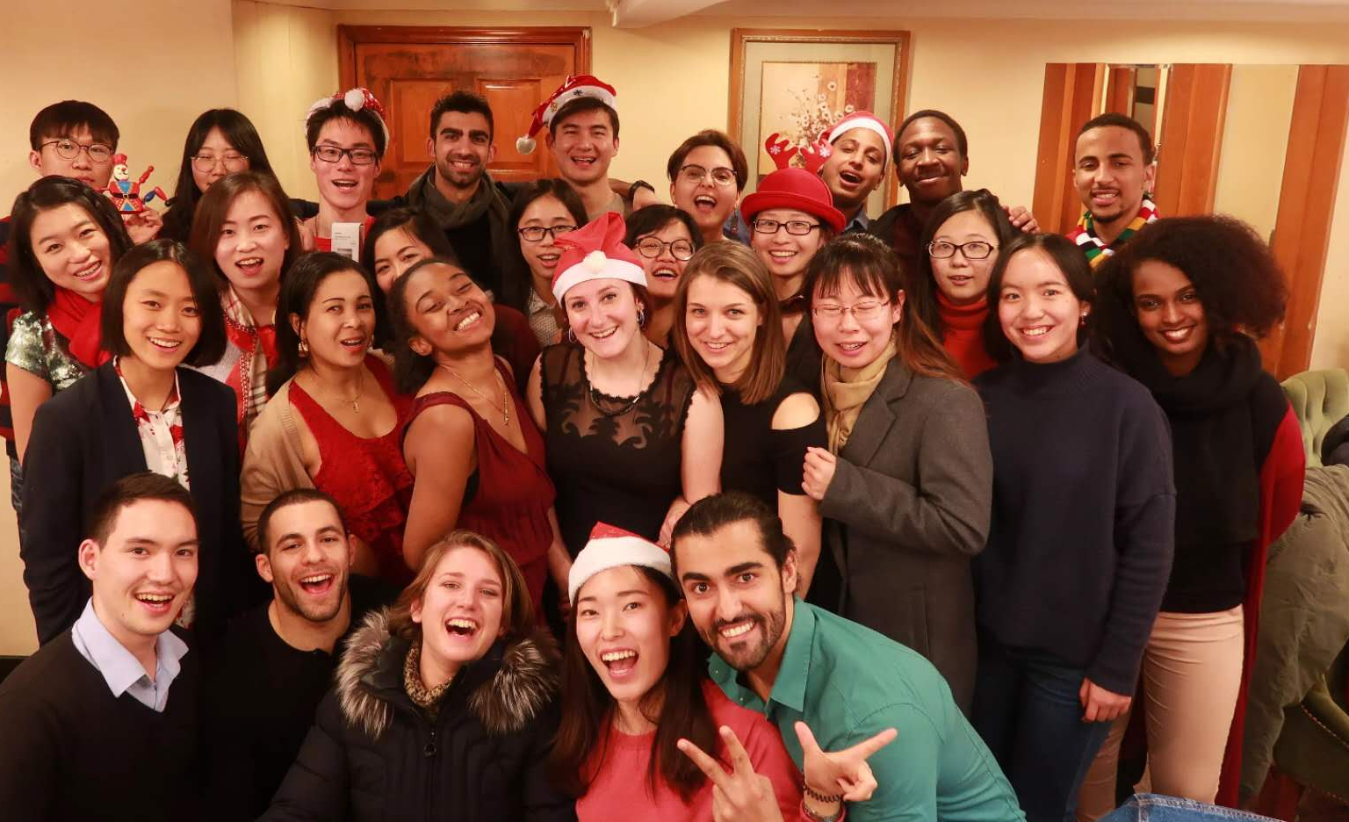
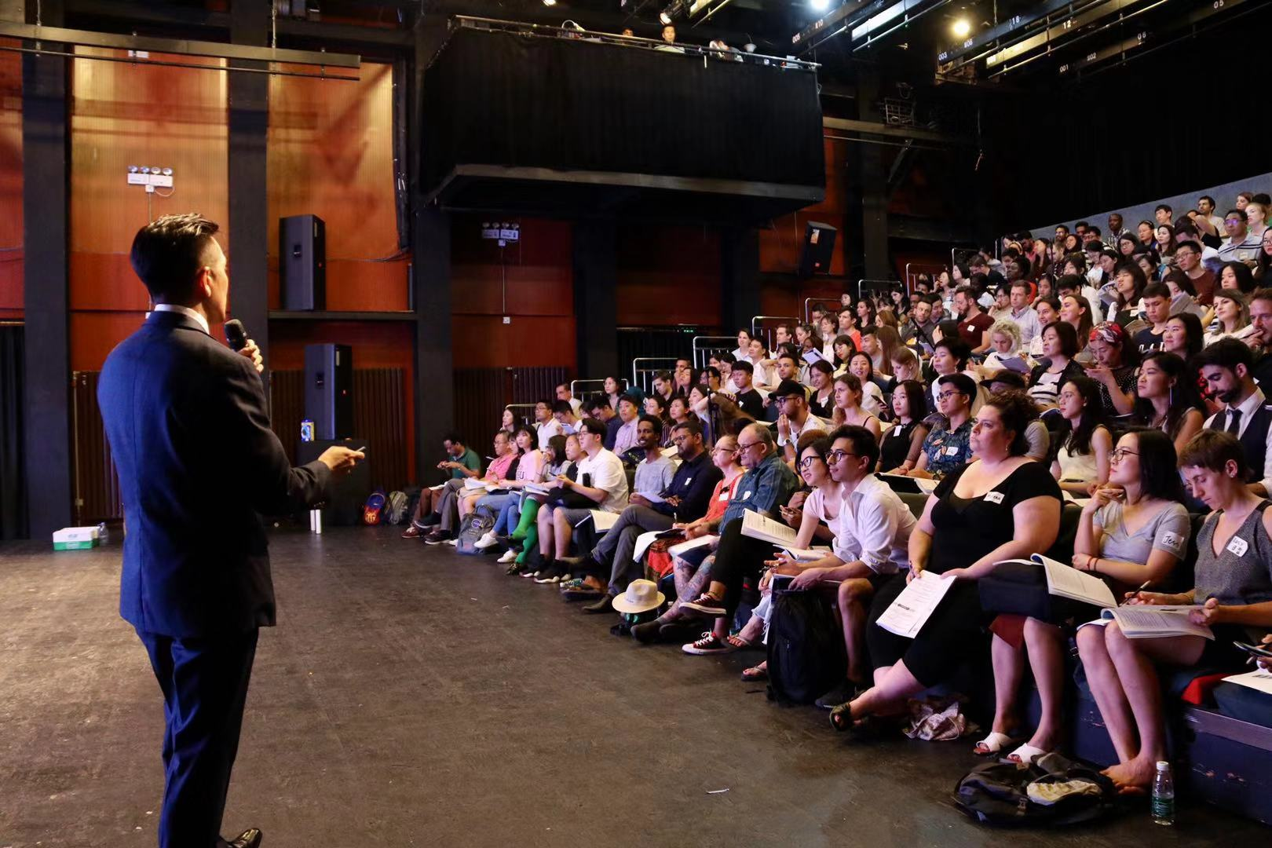
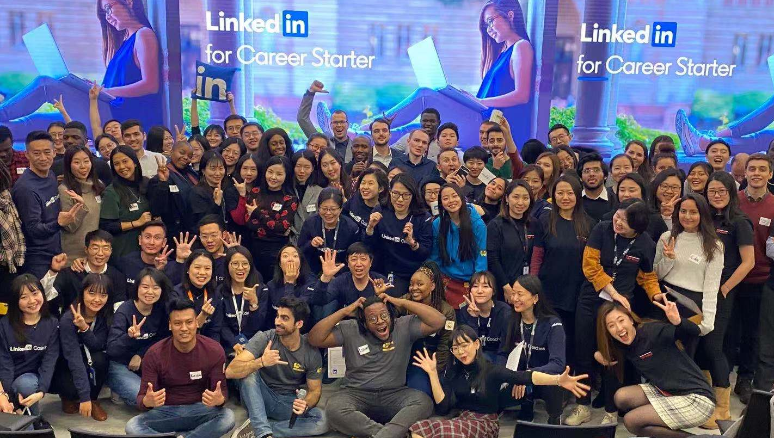
Pictures from events

Slide 7
Our Solution:
The go-to-community for career starters in China
College Students
Young Professionals
Career Starters
Career in
China
offline & online training
networking & matching events
on-demand courses
free content
Notes:
VALUE PROPOSITION
The go-to-community for career starters in China.
Through offline & online training, networking events,
on-demand courses and free content,
we fill the void between career starters & the workplace in China.
Bootcamp & Courses Topics for the first year:
1) Finding a Job at an International Company in China
3) Personal Branding on Chinese & Western Social Media

Slide 8
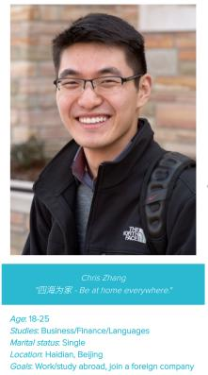
User persona
College students and young professionals interested in studying abroad or working in China.
Age: 18-35 Location: China
Goals: study abroad or work in China
Pain points: no local connections, job seeking online, face uncertainty and high competition
Notes:
https://app.xtensio.com/edit/j7oknwg0 – User persona builder
)

Slide 9
UNDERLYING MAGIC - how it all ticks
Differentiators
Useful Content
Experiential Learning
Bilingual Creators
Technology
Website - library
WeChat Groups - user interaction
WeChat Mini Program –
library/courses TBC
Notes:
ANGEL

Slide 10
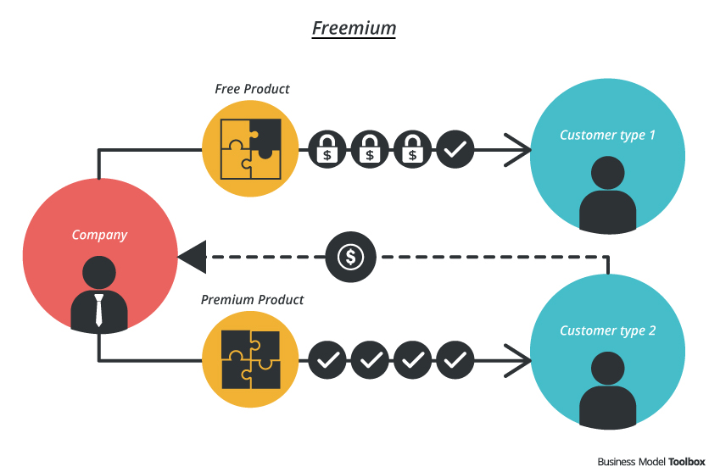
Video Library
Offline Networking
WeChat Community
Free Membership
Member
FREEMIUM
BUSINESS
MODEL
Premium Content
Client
On-demand online courses
Online & Offline Bootcamps
Networking & Matching Events
Summits
Notes:
Hybrid B2C Model that combines online & offline experiences for our users.
Tailored offline/online events, boot camps and on-demand online courses
B2b
In addition to b2c we also have b2b clients where we
provide workshops/cultural events/experience sharing, job fairs,
specialized training, Summits, Networking & Matching Events.
So far we have $5000 in revenue from these collaborations in 2020 and have renewed contracts for 2021 .
Having said that we believe that everyone should have access to
this information and that’s why we will offer a lot of content for free.
Free users will help us to refine our events and future products through ongoing testing and feedback. (Harris)

Slide 11
CURRENT MARKETING RESOURCES
Offline presence in Beijing/Shanghai
30+ collaborations with
universities & student groups
8000+ Learners
2500+ mailing list members
40+ WeChat Groups
Notes:
We plan to leverage our current marketing resources which include offline branding in two of China’s biggest cities, numerous collaborations with leading universities, student clubs and a community of thousands of learners accumulated over the past three years through organizing hundreds of events catered to serving the needs of our users.

Slide 12
GO TO MARKET PLAN
Notes:
Hi I’m Laura, I have 6 years of experience in marketing & PR in China. I will be leading the marketing efforts of BeHive.
By combining our current resources with content marketing across china’s most popular social media platforms - Wechat, weibo, douyin, we will educate, connect and empower our users.
(LAURA)

Slide 13
MARKETING FUNNEL
1
Awareness
Generate awareness through:
Free events & content
Word of mouth
Join WeChat Community
2
Video Library
WeChat Community Engagement
Website Registration
INTEREST
3
Email & influencer campaigns
Tailored event recommendations
Community survey
Consideration
4
On-demand online courses
Online & offline Bootcamps
Networking & Matching Events
Summits
Purchase
Notes:
There are many ways for new people learn more about BeHive and join our community. One is join one of our WeChat groups – a key marketing channel in China that can be used for communicating directly with our users, sharing useful content and informing them about upcoming BeHive Experiences. Another way for them is to join one of our online or offline events, register on our website and the most usual one is word of mouth – where current BeHive members recommend us to their friends.
In addition, by creating new collaborations with university student groups and leveraging influencer marketing, we will reach out to new audience who can join the community for free and then choose from our premium experiences.
(LAURA)

Slide 14
Market Segments – Year 1
International Students in China
Population: 500,000
Non-Chinese English Teachers in China
Population: 400,000
Capture 10% as Members
Population: 50,000
Capture 10% as Members
Population: 40,000
Convert 10% of Members
to Clients
Population: 5,000
Convert 10% of Members
to Clients
Population: 4,000
Members:
Follow BeHive on social media
Register as member on website
Join a BeHive WeChat Group
Clients:
Purchase one or more
BeHive Experiences
Estimated Annual Spending per Client: $ 9.4
Estimated
Market Value
$46,930
Estimated
Market Value
$37,540
Notes:
Petros

Slide 15
AFFORDABLE划算
Competition
What differentiates us:
Bilingual & International Creators
Price Point
Community Aspect
ONLINE
LEARNING
在线学习
EXPERIENTIAL
SOCIAL SETTINGS
体验式社交设置
EXPENSIVE昂贵
Notes:
Porter’s 5 forces compete with the international study fuctions of the companies
self development schools ETU School (silicon valley), moonshot academy in Beijing
Hangzhou, Yungu School
Competitive advantage – what we teach is applicable in life/work and any language
Include competititors specific names

Slide 16
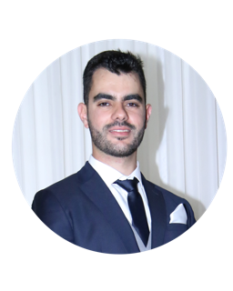
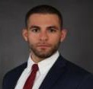
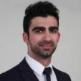
Management Team
angel
laura
Petros Djakouris
ColorfulClouds Tech.
University of Nottingham/UIBE
Harris Chrysanthou
Gigapower Energy
Tsinghua University
Angelina Strizhigauskayte
Daimler
Beihang University
周君彦Juliet
World Economic Forum
Beijing Foreign Studies University
Costas Georgiou
Chispo Attorneys at Law
University of Manchester/UIBE
Shewmay Ayesha Chang
Moody's Analytics
UIBE
Notes:
Same background, add all team members
Astrid, angela, arala,
Will add all core team members
Name Experience - company
University - major

Slide 17
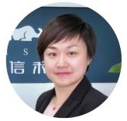
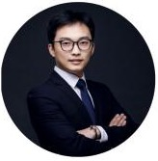
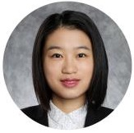
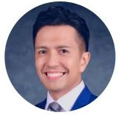
Advisors
Biman Liyanage
Co-founder & CEO
Wonder Technology
Maggie Mi
Managing Partner
Chispo Attorneys
Jelte Wingender 魏叶特
Senior Manager -
Corporate Innovation
Innoway
William Qiu
Executive Director
Turing Ventures
Yvonne Yu
Founder & CEO
Politech
Malcolm Nerva
Managing Director
Genowledge
Demetris hadjisophocles
Menelaos menelaou

Slide 18
FINANCIALS
In a booming 20 ……
Projections & goals in year 1
Break even,
users/learners (how to engage with them – these people are either following us on wechat/weibo/tiktok, member in
A wechat group, subscribed for our mailing list, attended any offline/online event/ goals

Slide 19
NEXT STEPS
Considering different ways to improve what we do and grow our userbase
Expand to other major cities in China
Ultimate behive experience
Mentorship platform
Recruitment
B2b
First year = capture our audience, amplify our reach & then explore
Notes:
time, money lost on recruitment, training, compensation, etc.
long lasting negative effects on a team or company’s culture - reduced productivity or morale.
Kai Fu Lee said that he believes 40% of the world’s jobs will be replaced by robots capable of automating tasks
Only about a third of U.S. companies report that they monitor whether their hiring practices lead to good employees Harvard Business Review- https://elb.hbr.org/2019/05/recruiting#your-approach-to-hiring-is-all-wrong
The time companies spend on job interviews and hiring processes has grown in recent years, internationally. – Glassdoor (2015)
TRAINING:
Specialized soft skills training is expensive and not easily accessible to students.
Skills training is not tailored for students who want to work/study abroad.
HIRING:
Traditional hiring methods are costly, time-consuming, and sometimes fail at selecting the best talent.
Bad employee hires can bring short- & long-term negative effects to companies.

Slide 20
Products | 产品
Skills workshops 技能工作坊
Membership 会员制
Networking events 社交活动
Job fairs 招聘会
Leadership Boards 领导力排行榜
Certification 证书
Website Optimization 网站优化
Online courses 在线课程
Long-term Programs 长期项目
On-the-Job Simulation 特定职位情景模拟
Current
已出品
In works
研发中
Future
下一步
Notes:
Incorporate in the business model
Gamification trainers students
Add timeline --- steps before product release, etc
Online & Offline Events: Branding
Partnerships: University Career Services, Associations & Clubs, Venues, Co-work spaces
Social Media Campaigns/ Giveaways/Vlog

Slide 21
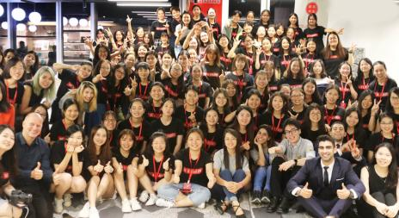
Current Products | 现有产品
Our interactive workshops allow participants to practice and develop 21st Century Skills, step out of their comfort zones and build their network in a safe and welcoming environment.
我们的互动式工作坊能够让参与者锻炼他们的21世纪技能，跳出他们的舒适圈，在一个安全友爱的环境中培养自己的社交圈。
Our promise:
我们承诺：
Something new. For everyone. Every time.
每次活动都是给每个人准备的新体验。
Experiential learning.
体验式学习。
Non-judgmental but personally challenging.
富有挑战性但不批判任何人。
Notes:
Incorporate in the business model
Gamification trainers students
Add timeline --- steps before product release, etc
Online & Offline Events: Branding
Partnerships: University Career Services, Associations & Clubs, Venues, Co-work spaces
Social Media Campaigns/ Giveaways/Vlog

Slide 22
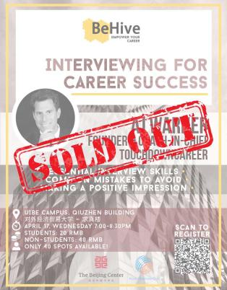
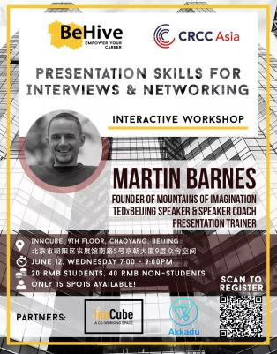
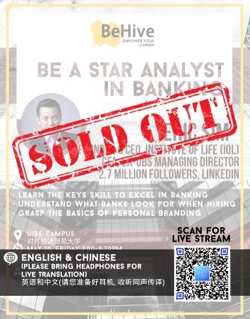
Current Products | 现有产品
No. | Title | Trainer | Topic Introduction | Key Takeaways | Target Skills
1 | Interviewing for Success | AJ Warner, Entrepreneur and Education Consultant | Interviews can be seen as very scary and intimidating, but with this workshop you will be excited to nail your next interview with confidence. | Effectively introduce yourself in 30 seconds Rock questions with the STAR method Seal the deal with a great follow-up email | Communication Presentation Body Language
2 | Presentation Skills for Interviews & Networking | Martin Barnes, TEDx Speaker, Presentation Coach | We will guide you through finding your own unique presentation style to use during interviews, presentations or even when pitching your ideas to investors! | Effectively introduce yourself in 1 minute Improve your presentation skills for interviews, meetings and customer interactions Participate in a simulated pitch challenge | Presentation Public speaking Communication Body Language
Notes:
Incorporate in the business model
Gamification trainers students
Add timeline --- steps before product release, etc
Online & Offline Events: Branding
Partnerships: University Career Services, Associations & Clubs, Venues, Co-work spaces
Social Media Campaigns/ Giveaways/Vlog

Slide 23
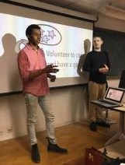
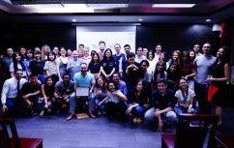
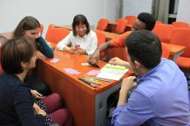
Current Products
现有产品
Skills workshops: 20 – 50 RMB 技能工作坊：20-50人民币
Public-speaking, Storytelling, Self-awareness, Intercultural
Communication, Presentation, Interview Skills, and more…
公共演讲、故事陈述、个人认知、跨文化交际、展示技巧、面试技巧等等
Membership: 50 – 100 RMB 会费：50-100人民币
Networking events: 20 – 60 RMB 社交活动：20-60人民币
Job fairs: Free – 40 RMB 招聘会：0-40人民币
Notes:
Incorporate in the business model
Gamification trainers students
Add timeline --- steps before product release, etc
Online & Offline Events: Branding
Partnerships: University Career Services, Associations & Clubs, Venues, Co-work spaces
Social Media Campaigns/ Giveaways/Vlog

Slide 24
Products: In works & Future研发中产品及下一步产品
Leadership Boards 领导力排行榜
Competitions, Voting, Debates
竞争、投票、辩论
Website Optimization & Online courses 网站优化以及在线课程
User Profile
用户简介
Videos & Exercises
视频&练习
Long-term Programs: 200 – 400 RMB 长期项目：200-400人民币
Different programs with multiple trainings 涵盖不同培训的不同项目
On-the-Job Simulations: 50 – 150 RMB 特定职位情景模拟：50-150人民币
A day in the life of a salesman/lawyer/banker/marketer 一天体验销售/律师/银行家/营销人员的生活
In works
研发中
Future
下一步
Notes:
Incorporate in the business model
Gamification trainers students
Add timeline --- steps before product release, etc
Online & Offline Events: Branding
Partnerships: University Career Services, Associations & Clubs, Venues, Co-work spaces
Social Media Campaigns/ Giveaways/Vlog

Slide 25
Our clients | 客户

Slide 26
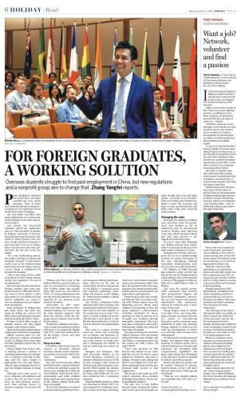
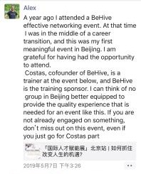
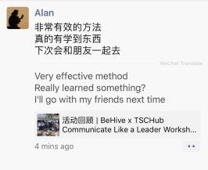
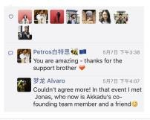
Press & User Testimonials
媒体报导 & 用户好评
Notes:
1.

Slide 27
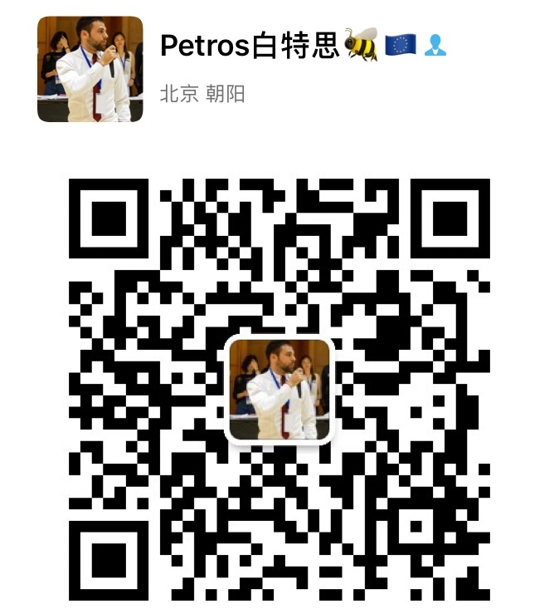
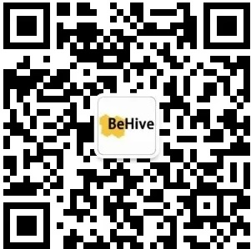
#behive_fam
interactive professional diverse suc
Contact Details:
Petros Djakouris
Telephone: 13121540571
WeChat: petros1992
Thank you
let’s keep in touch

